Slide 1

MANAGING DIFFICULT CONVERSATIONS

Slide 2


Background
Difficult conversations are valuable open dialogues that tackle emotionally charged topics like negative feedback (Jacobs et al., 2011; Lichtenberg et al., 2007; Priftanji et al., 2020).
Despite the discomfort involved, effective leaders understand the crucial role such conversations play and their benefits in organisations (Farrell, 2015)
The training
An internal training delivered by a Learning and development manager at HCPC
One-day online training of about 3 hours.
Participants were divided into teams.

Slide 3
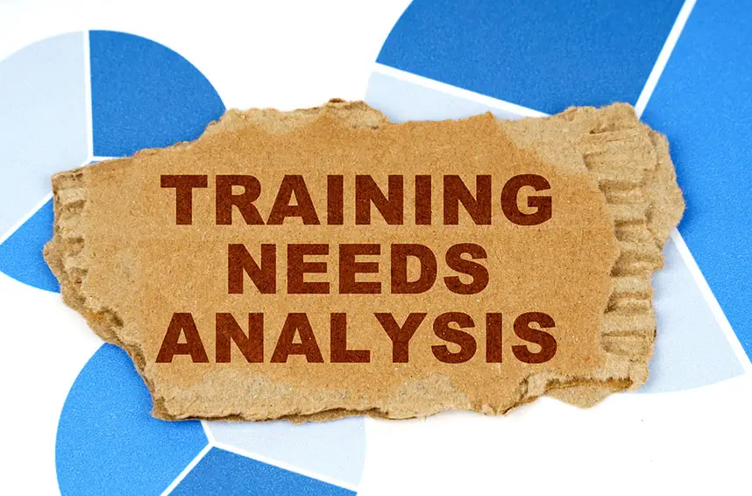

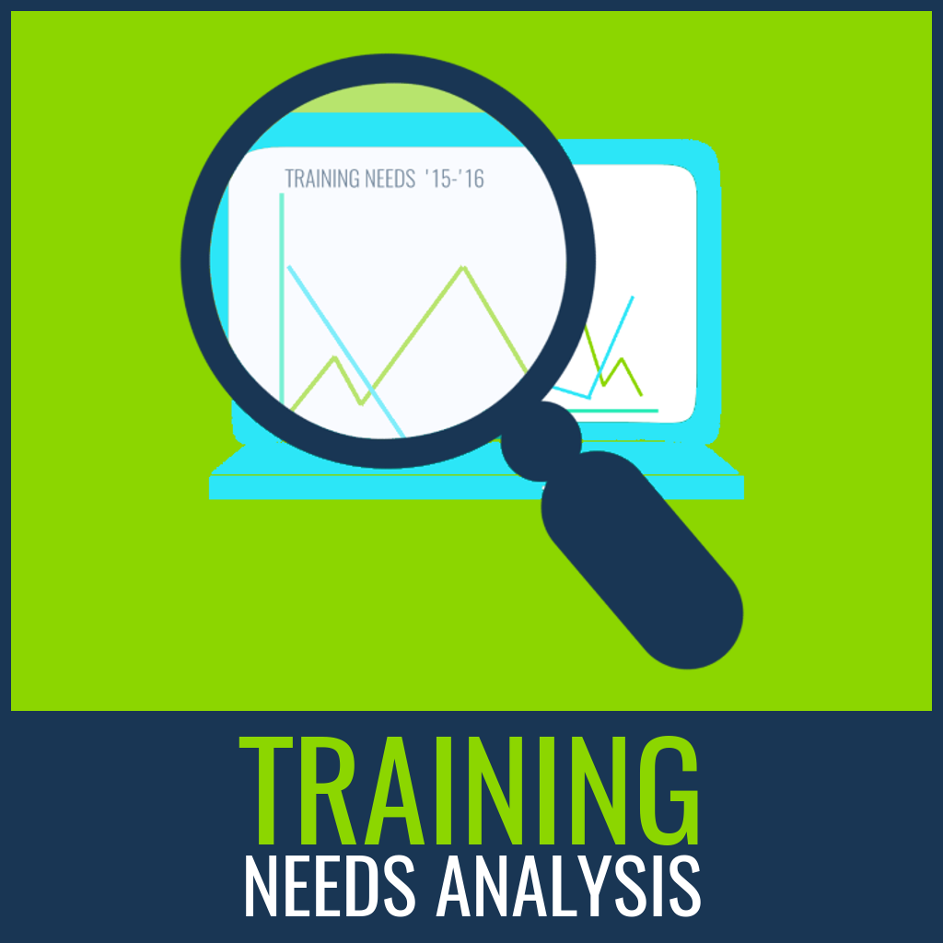


Training objectives
Understanding the various types of challenging conversations, their reasons for difficulty, and the consequences of avoiding them.
Learning how to prepare for difficult conversations, focusing on achieving positive outcomes.
Identifying constructive ways to express feelings and concerns using language, leading to productive outcomes.
Practicing effective planning and preparation strategies for engaging in difficult conversations.
Training needs identification
Data gathering
Analyse Data
Identify Training Solutions
Develop Training Plan
Implement Training
Evaluate Training Effectiveness
Follow-Up and Support
Define Objectives
(Brown, 2002; Denby, 2010)

Slide 4
Strengths
Inclusion of case studies and roleplay
Weaknesses
Limited time
No follow-up
Limited evaluation and feedback
Depth of understanding
Retention and application
Time for reflection
Delivered by an expert
Practical strategies
Effective communication
Planning and preparing for difficult conversations
Ethical compliance

Slide 5


Recommendation
Extend Training Duration
Implement Follow-Up Sessions
Enhance Evaluation and Feedback Mechanisms
Foster Retention and Application
Offer Ongoing Support
Improve Interactive Elements
Customise Content
Provide Personalized Feedback
Expert Facilitation

Slide 6
References
Brown, J., 2002. Training needs assessment: A must for developing an effective training program. Public personnel management, 31(4), pp.569-578.
Denby, S., 2010. The importance of training needs analysis. Industrial and commercial training, 42(3), pp.147-150.
Farrell, M., 2015. Difficult conversations. Journal of Library Administration, 55(4), pp.302-311.
Jacobs, S.C., Huprich, S.K., Grus, C.L., Cage, E.A., Elman, N.S., Forrest, L., Schwartz-Mette, R., Shen-Miller, D.S., Van Sickle, K.S. and Kaslow, N.J., 2011. Trainees with professional competency problems: Preparing trainers for difficult but necessary conversations. Training and Education in Professional Psychology, 5(3), p.175.
Lichtenberg, J.W., Portnoy, S.M., Bebeau, M.J., Leigh, I.W., Nelson, P.D., Rubin, N.J., Smith, I.L. and Kaslow, N.J., 2007. Challenges to the assessment of competence and competencies. Professional Psychology: Research and Practice, 38(5), p.474.
Priftanji, D., Hill, J.D. and Ashby, D.M., 2020. Managing difficult conversations. American Journal of Health-System Pharmacy, 77(21), pp.1723-1726.

